Slide 1
Wildlife Detection and Count in Aerial Photography
Aian Rosales
MSDS 2019

Slide 2
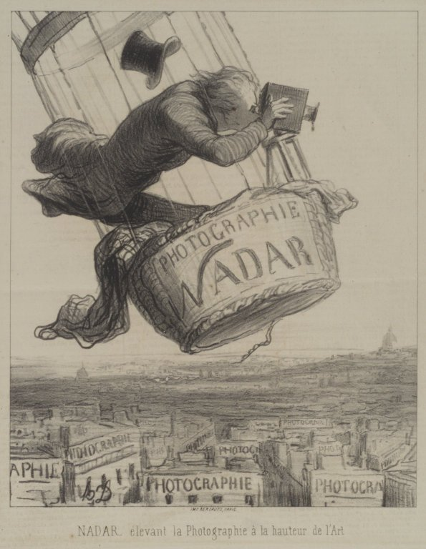
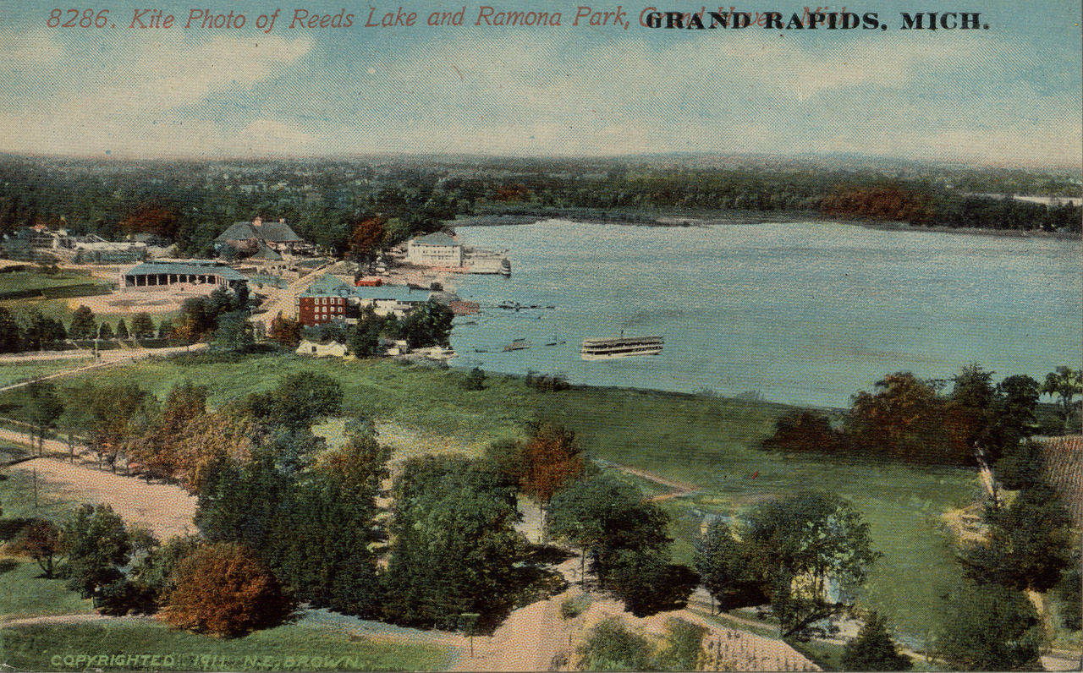
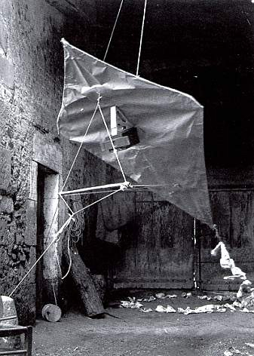
History of Aerial Photography
Photographs taken over Paris by balloonist Nadar in 1858 (pictures not preserved)
Earliest surviving photograph titled “Boston, as the Eagle and Wild Goose See It” by Wallace Black and Samuel Archer King
Kite aerial photography pioneered by E.D. Archibald in 1882 using explosive charges as timer

Slide 3
History of Aerial Photography
World War I – reconnaissance aircrafts for enemy movement monitoring
Frederick Laws - Stereoscopic effect (60% overlap) – perception of depth
World War II – use of small, quick planes to perform recon missions – Sidney Cotton and Maurice Longbottom
Present – Satellites, model aircrafts and drones are used for aerial photography

Slide 4
Aerial Wildlife Photography
Ecologists and conservationists consider aerial photography as an invaluable tool in protecting wildlife
They can count how much wildlife thrives in a certain area, with the added advantage of reduced human contact, to reduce stress to the observed animals
University of Adelaide demonstrated better results of wildlife identification and count using the drones to take pictures of decoy ducks
At the same time, scientists on the ground are also manually counting the decoys laid out
Data from drones were shown to be 43%-96% percent more accurate than counting them using the view from the ground
Drones are also used to survey plant ecology using a vegetation map and even crowd size using the Jacobs Crowd Formula

Slide 5
Methodology
Images of wildlife scraped from the Internet were used as inputs for this project
Bovines
Fish seen above the ocean
Birds
Humans
Umbrellas (neutral classification)
Thresholding was applied to aid in the eventual segmentation of the individual elements in the pictures
Morphological operation techniques (opening and closing) were used to further clean out the images (further reducing artifacts that may affect count)
Blob detection using skimage’s regionprops were used to segment the elements (animals and objects); properties were then recorded as features for the Machine Learning models for object identification

Slide 6
Methodology
Properties (features) extracted:
Eccentricity
Minor axis Length
Major axis Length
Minor axis Length/ Major axis Length
Convex Area
Hu Moments (7 individual features) – chosen due to their scale-, transformation-, and rotation-invariance
Regionprops extracted were then fed as training-test data for the ML models (Highest accuracy achieved by Random Forest; lowest, k-Neighbors)
Using these models, I then tested these to various types of images:
Same picture with same morphological operations, but cropped
Same picture with same morphological operations, but cropped and rotated
Merged pictures with different morphological operations applied
New pictures not fed into the training dataset

Slide 7
Results
Was able to extract blobs successfully in the images, but it required considerable effort in pre-selecting images with very well-segmented elements
Test accuracy results achieved:
Random Forest – 77%
K-Neighbors – 65%
fdas

